Slide 1
Using Technology in PE
Brian Kessler
Helena High School
President, SHAPE Montana

Slide 2
Flipgrid
Please try and download the app Flipgrid
Once downloaded, enter code: 906f8c
Password is SHAPE2018
Should show that you have joined SHAPE Montana Conference 2018
We will come back to this a little later

Slide 3
Heart Rate Monitors
What do you use?
How do you use them?
Current Research on their use…
Should not be a stand alone activity
Should be used a means to help students understand 5 Components and FITT
Need to be used to teach about MVPA
Should help students recognize how a workout should be completed with intense workout portions and portions of recovery

Slide 4
IHT
IHT Heart Rate Monitors
Electronic, but not Bluetooth
Very reliable
Computer shows students how their heart rate changes throughout a workout
Can be emailed home, can also use to look at trends
App on phones available as well

Slide 5
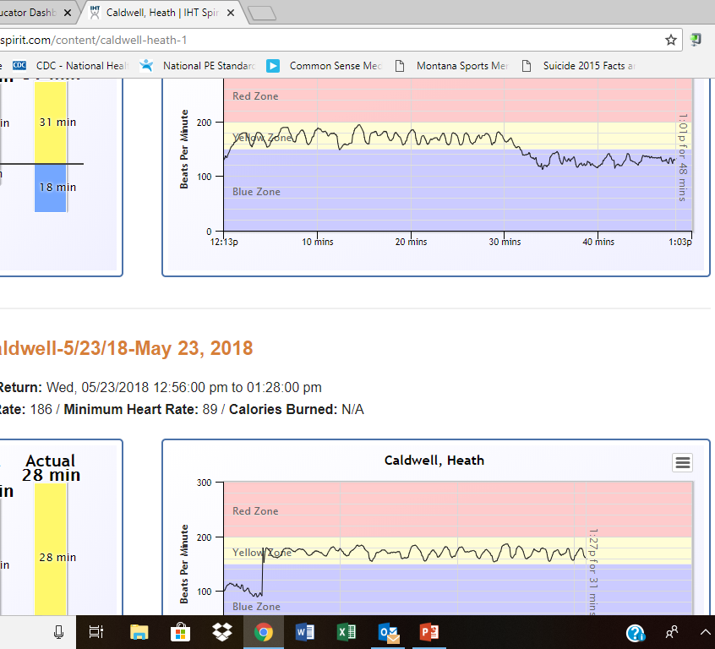
Red zone – above THRZ
Yellow zone – THRZ
Blue zone – below THRZ
Shows times and how student did in workout

Slide 6
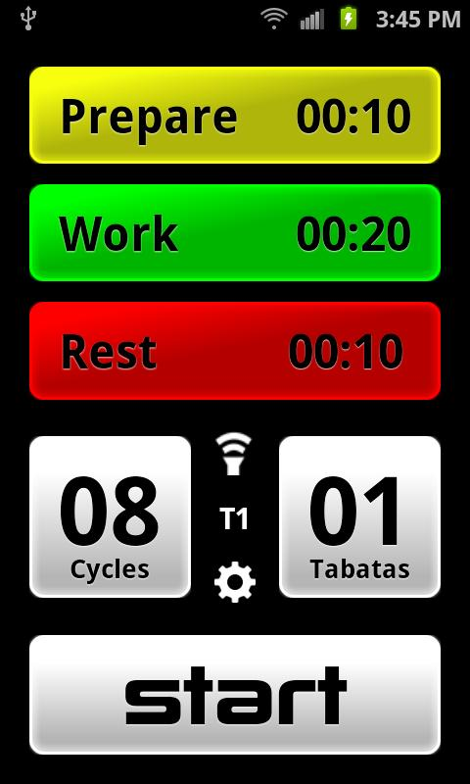
Workout with HR Monitors
Tabata Pro App
Tabata workout with students
10 second prepare, 20 second workout, 10 second rest, repeat
As many cycles as you would like
As many Tabatas (part of a work out) as you would like
Check out a HR Monitor
Find space

Slide 7
Tabata Workout
Cycle 1: Crunches
Cycle 2: Push ups
Cycle 3: Body squats

Slide 8
Professional Development
Use Twitter!
Twitter Chats (look for different #s)
Follow leaders in the profession – always posting things
Put yourself out there!
Webinars
SHAPE America
What other ways?
PE Geek

Slide 9
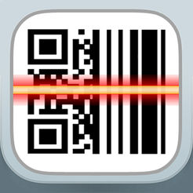
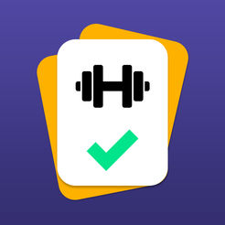
Apps to Use
Sweat Deck
Team Shake
Fooducate
QR Reader
Coach’s Eye
PE Geek has lists of top apps for everything you would need

Slide 10
Flipgrid Scavenger Hunt
Given Clue #1
Figure out the clue in a group – go to that location
Another sheet of paper will be there with a question for you to answer
Using Flipgrid, send in your answer!
Come back to gym when done

