Slide 1
Teambuilding Ideas to Strengthen Students Mentally, Physically & Socially
Sara Russell 2016 SHAPE America National High School Physical Education TOY SHAPE Washington President Tahoma High School Maple Valley, WA

Slide 2
Outcomes
Understand the positive impact teambuilding activities can have your students and your classes.
Learn activities that can easily be implemented into your classes.
Be able to relate and connect skills taught through cooperative and teambuilding activities to other sports/games taught in class.

Slide 3
Using teambuilding challenges to meet the standards …
Standard 4 - Exhibits responsible personal and social behavior that respects self and others.
Standard 5 - Recognizes the value of physical activity for health, enjoyment, challenge, self-expression and/or social interaction.

Slide 4
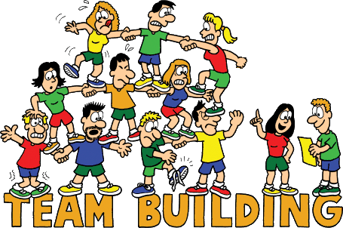
•Problem solving
•Trust
•Cooperation
•Communication
•Teamwork
•Leadership
•Challenge

Slide 5
THANK YOU!!!
Sara Russell srussell@tahomasd.us @savarussell
A special thank you to Sportime featuring Spark for the equipment!

