Slide 1
Quasi-Project and Standards Based Health Education
Brian Kessler
Health Enhancement Teacher – Helena High School
SHAPE Montana President

Slide 2
Welcome!
Brian Kessler
6 years in Education
2 years Middle School , 4 years High School
BS from Montana State University
President of SHAPE Montana
Department Chair – Helena High

Slide 3
Problem
Health is a continuous subject
How do I make it relevant to high schoolers?
Book work = no real learning
Same stuff, different day
Sophomores in high school are already having sex, doing drugs, and have begun to make decisions that affect lifelong health

Slide 4
Potential solution?
Project based learning
Standards based learning
Allows for application of knowledge
Gives opportunities for students to see and recognize the importance of healthy lifestyles

Slide 5
Montana State Health Education Standards
HES1: Comprehend concepts related to health promotion and disease prevention to enhance personal health
HES2: Analyze the influence of family, peers, culture, media, technology, and other factors on health behaviors
HES3: Demonstrate the ability to access valid information, products, and services to enhance health
HES4: Demonstrate the ability to use interpersonal communication skills to enhance health and avoid or reduce health risks
HES5: Demonstrate the ability to use decision-making skills to enhance health and safety
HES6: Demonstrate the ability to use goal-setting skills to enhance health
HES7: Demonstrate the ability to practice health-enhancing behaviors and avoid or reduce health risks
HES8: Demonstrate the ability to advocate for personal, family, and community health

Slide 6
Beginning of the Year
Life maps
Cover Pages
Create connections, learn about your students
Personal Hygiene?

Slide 8
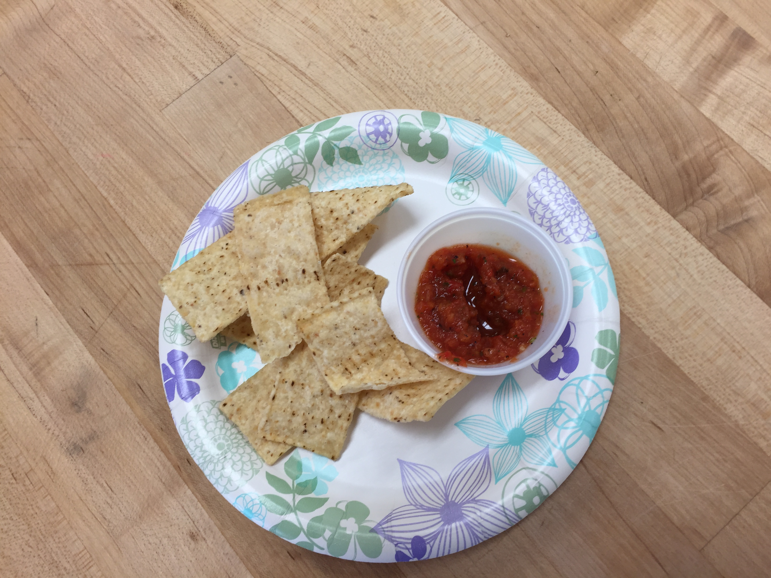
Nutrition
New approach this year
Partnered with school food service
Partnered with Culinary Teacher
Meals every other Friday (Fun Food Fridays!)
Assignment with each day
Read and react to nutrition label
Determine nutrients present, offer an alternative, healthier option
Create a nutrition label and answer questions
Nutrients
Fast Food comparisons

Slide 9
Mental Health
Discussion on Mental Health
Assign Mental Health disorder
Poster project
Adds research component
English component
Stress project
Personal expression
Realization of coping mechanisms

Slide 10
Human Sexuality
Contraceptives
Intro discussion
Group discussions about touchier aspects
Stages of Pregnancy
How do we make it realistic and necessary to understand?

Slide 11
Body systems
Connection between Freshmen PE and Health
Major muscle groups
Muscle Rap
Cartoon Skeletons

Slide 12
https://youtu.be/7-f1Nozfnto

Slide 13
Indian Ed for All
How do we cover this in Health?
Final project this year, combined all health units this year
Utilized OPI resources
Assigned a tribe (2-3 people per group)
Needed to research about the tribe
Answer questions related to healing, traditional medicine, spiritual aspects, dances, etc.
Present information and write and an essay

Slide 14
Grading – Creating Rubrics
Standards-based, makes it easier
Clear, but simple

Slide 15
Technology
Movies/Videos
Plickers
Kahoot!
Everfi?
Daqri

